Slide 1
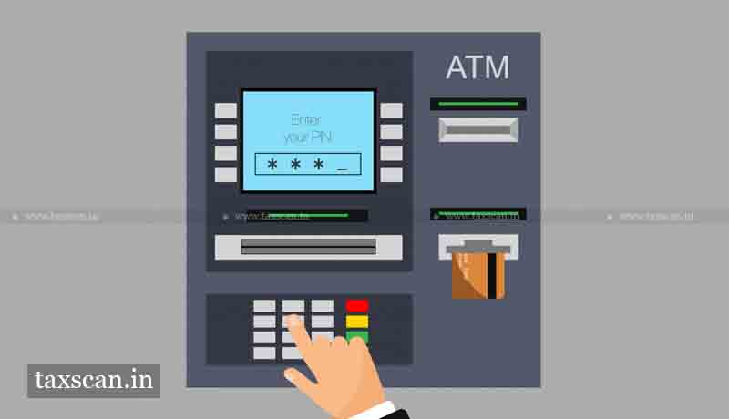
Bank TRANSACTION SYSTEM
Supervisor:
Mrs. Vijaya Madhavi
Team: Spartans
1) N Vamshee Teja
(2453-18-733-164)
2) B Anupama
(2453-18-733-128)
3) P Jashwanth
(2453-18-733-167)

Slide 2
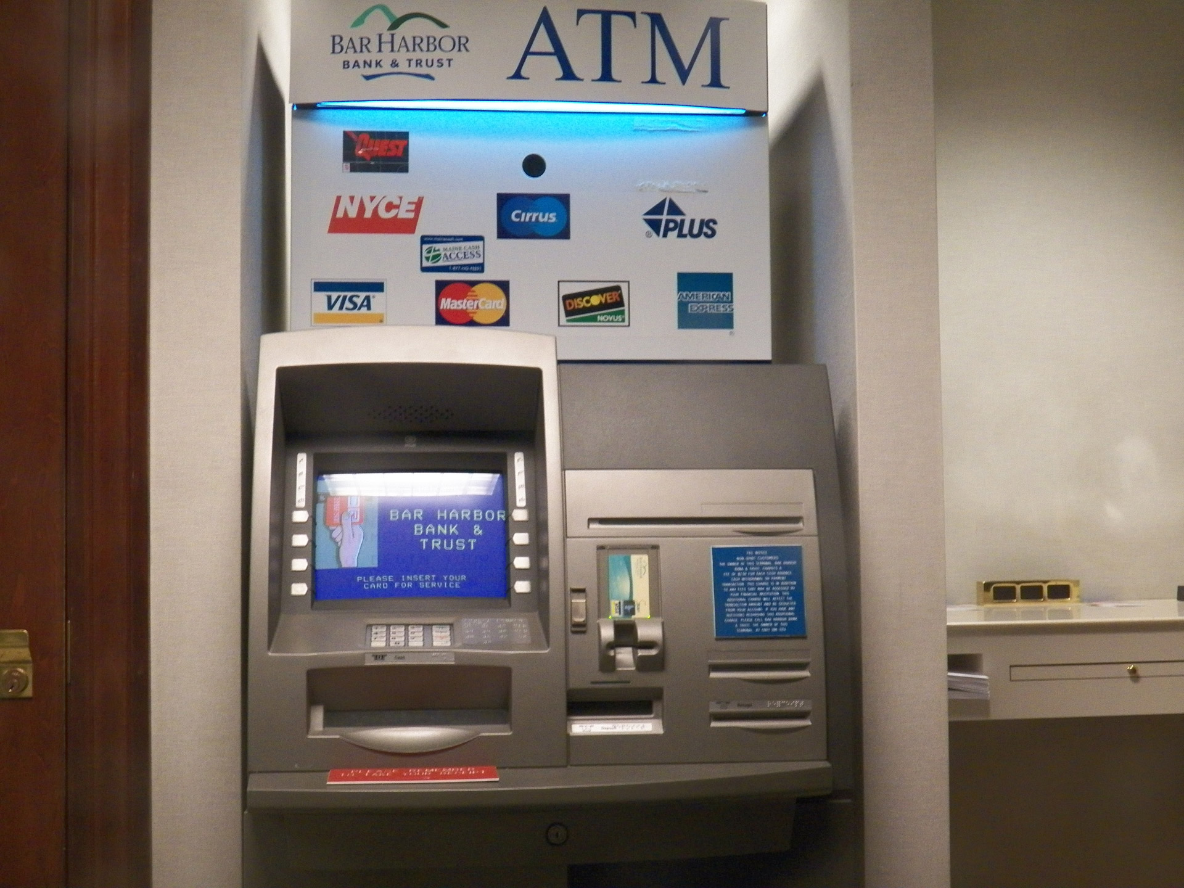
What and why is an atm?
An Automatic Teller Machine (ATM) is a Specialized Computer that allows bank account holders to:
check their account balances
withdraw or deposit money
print a statement of bank transactions

Slide 3
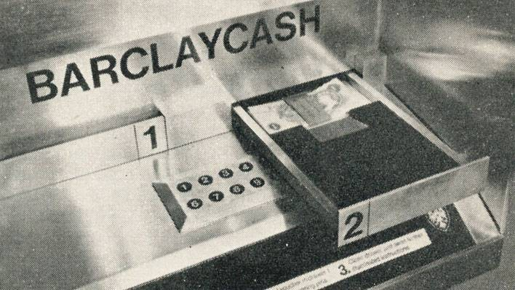
Atm evolution
1960
Luther George Simjian (America) invented the Bankograph (a machine that allowed customers to deposit cash and cheques into it)
1967 (Worlds First ATM was set up)
First ATM was set up in June 1967 on a street in Enfield, London.
John Shepherd Barron (British) is credited with its invention.
By 1984
ATM installed worldwide were 1,000,000 (1 million).
As of 2018
ATM installed worldwide were more than 3 million.

Slide 4
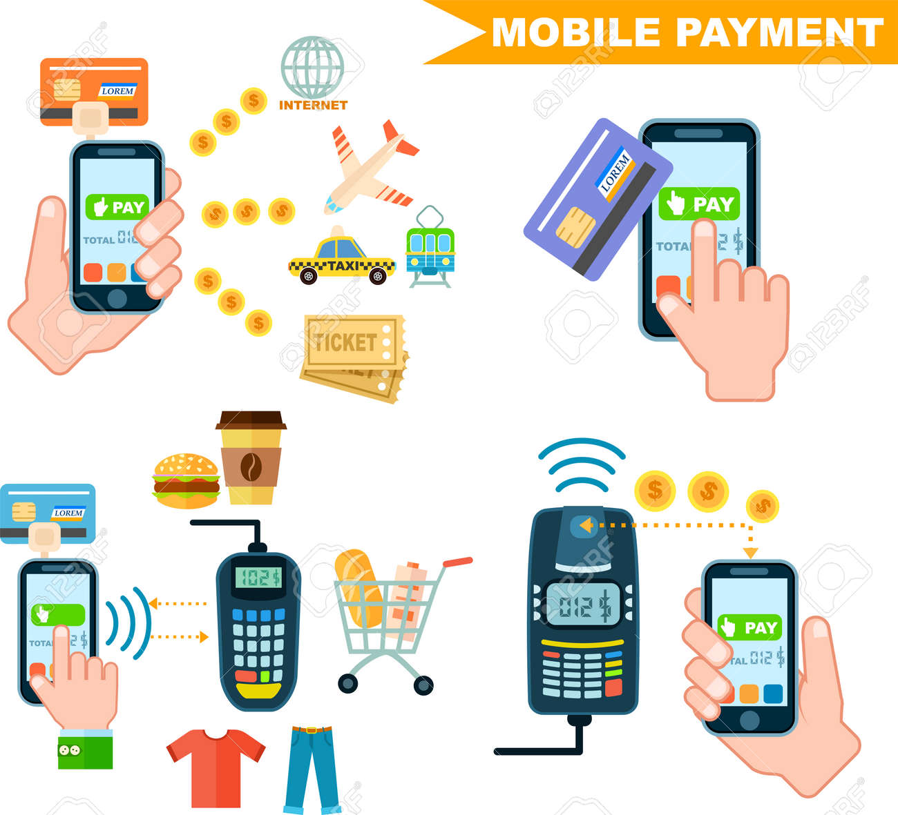
Importance of atm Banking system
Even though Digital payment services are gaining popularity in the 21st century, CASH is still preferred in most of the parts of the world for transactions.
Everyone may be using the digital payment services, but the same people tend to keep a few amount of cash in their wallet while going out, because we don’t know at what time we need money.

Slide 5
Tools and technologies
Programming Language: Python
User Interface: Python tkinter module
OTP Verification: Twilio API
Database: DB browser Sqlite3 database

Slide 6
ATM FRAUDS
The first decade of the 21st century saw a rise in the number of ATM frauds via sophisticated malware or technologies, such as skimming devices. To stay one step ahead, banks developed software that could detect anomalies in transactional data that hint towards illegal activity.

Slide 7
Drawbacks of existing system
Not safe for customers. for their transaction.
If card pin is leaked, the card can be misused

Slide 8
Proposed system
An OTP (One Time Password) will be sent to the registered mobile number linked with account every-time when a customer makes a transaction.
Transaction will only be committed iff, the OTP will be matched.
Else the transaction cant be performed.

Slide 9
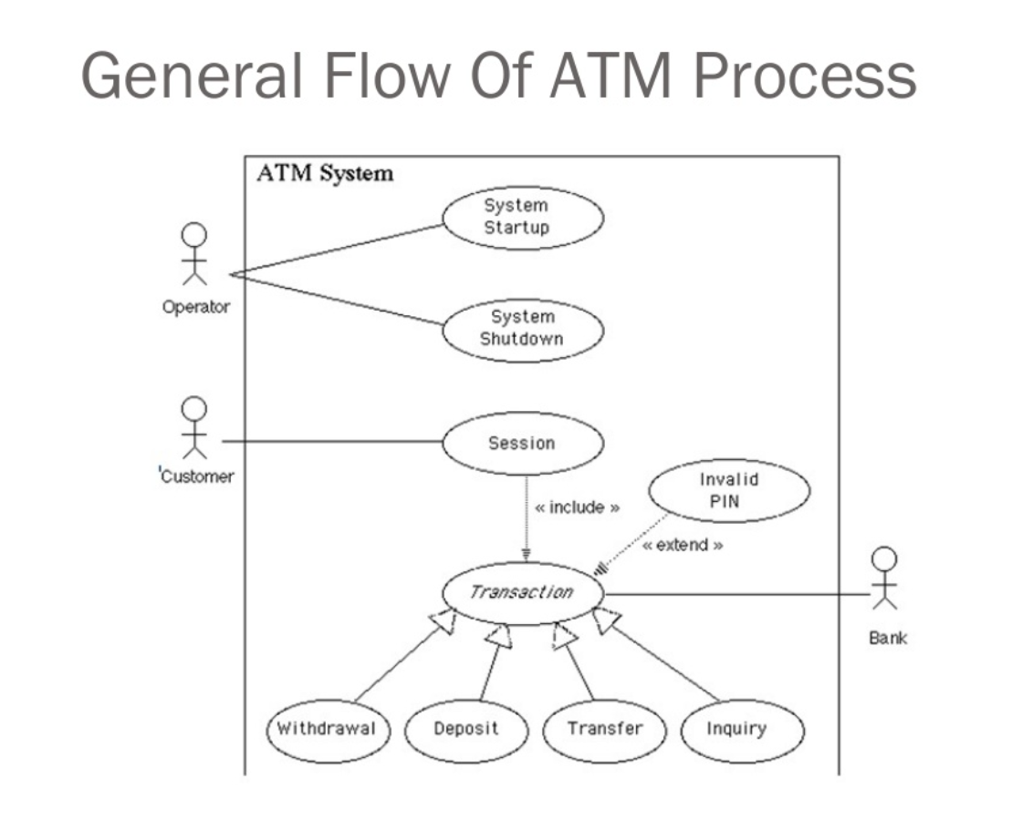
SYSTEM DESIGN
GENERAL FLOW OF ATM PROCESS

Slide 10
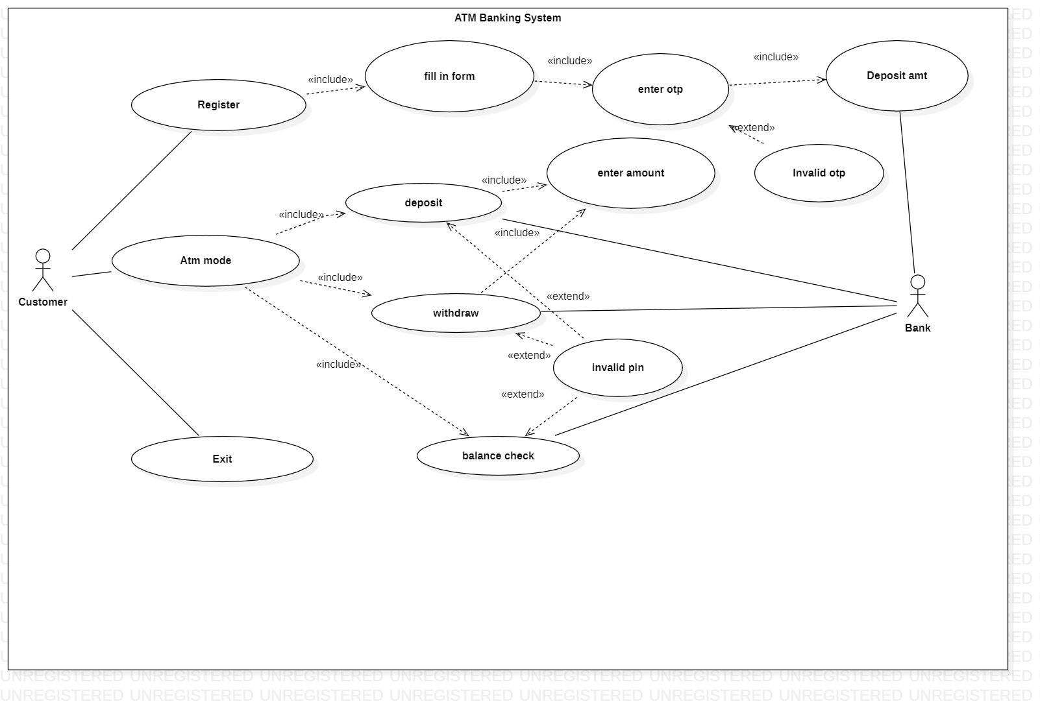
Use case diagram

Slide 11
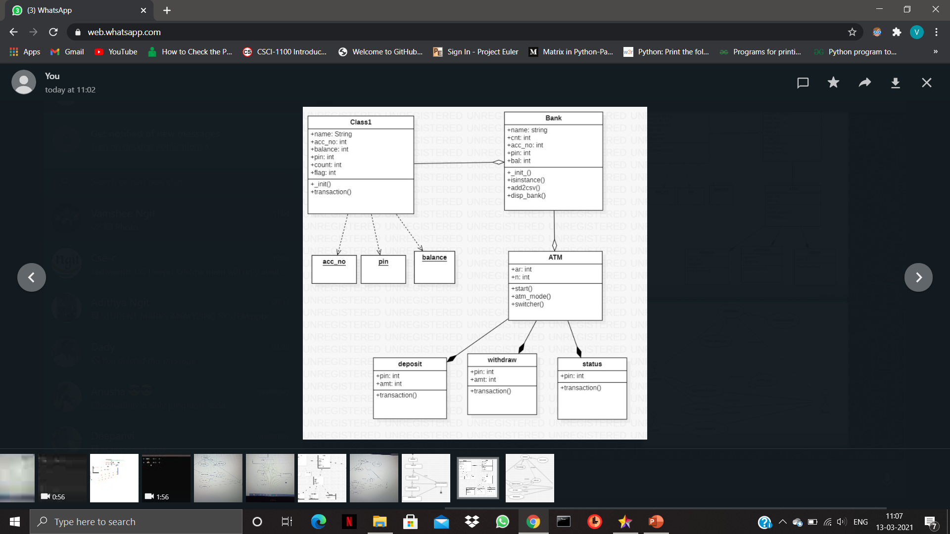
Class Diagram

Slide 12
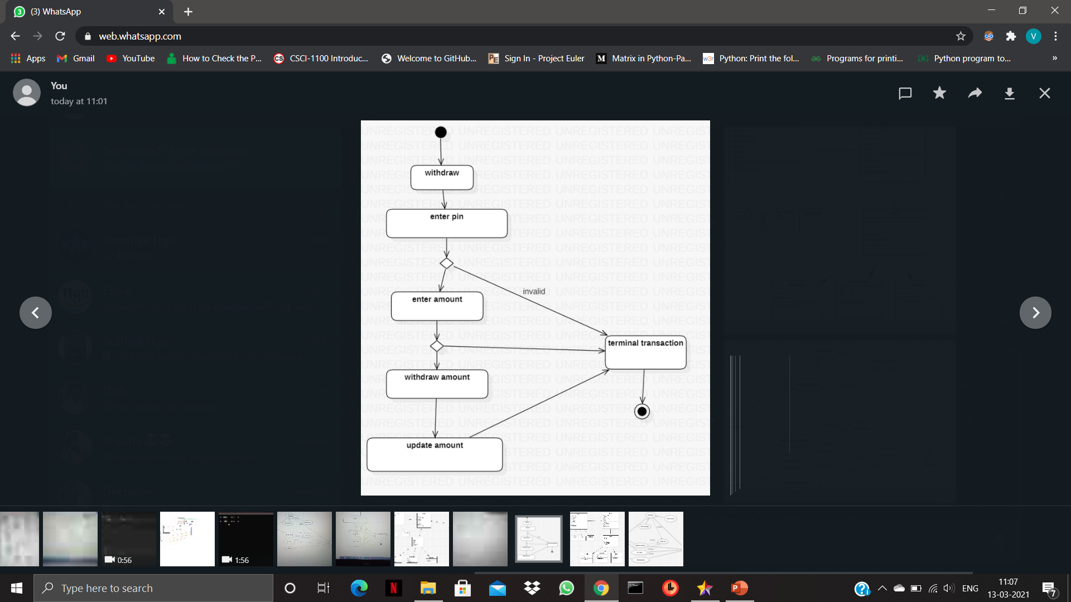
Activity diagram

Slide 13
CONCLUSION
So by collaborating we could conclude that there is more to add for securing the ATM transactions Virtually to be hidden from the Hackers and people who are doing frauds stealing the personal information for illegal purposes etc.

